Slide 1
Gut Microbial Diversity Differences in MDD Patients With Recent Suicide Attempts
Morrow Zhang
BIOMI 4300

Slide 2
Gut microbiome–brain interactions suggest a potential role in suicide-related behavior
The gut microbiome communicates with the brain through immune and metabolic pathways (gut–brain axis)
Microbiome differences have been linked to psychiatric and neurological disorders

Slide 3
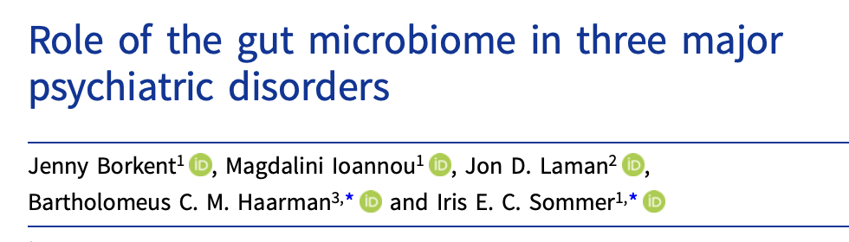
Gut microbiome dysbiosis may contribute to psychiatric disorders through immune and metabolic pathways
Gut microbiome disruptions (dysbiosis) have been associated with major depressive disorder and other psychiatric conditions (Borkent et al.)
Dysbiosis may increase intestinal permeability, allowing bacterial components to trigger systemic inflammation
Chronic inflammation and circulating microbial metabolites may alter neural and immune pathways involved in mood and behavior

Slide 4
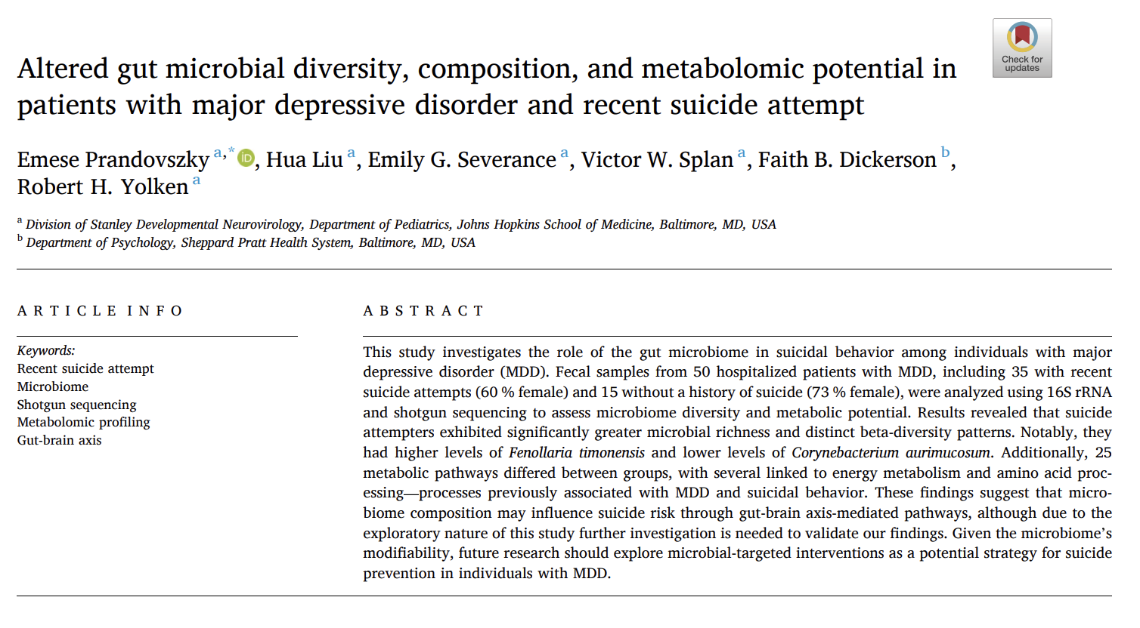
Gut microbiome–brain interactions suggest a potential role in suicide-related behavior
Microbiome differences associated with suicide behavior remain understudied

Slide 5
Gut microbiomes from 50 MDD patients were profiled using 16S rRNA sequencing
Recruited 50 MDD hospitalized patients (35 attempter and 15 non-attemper)
Performed 16S rRNA Amplicon and Shotgun DNA sequencing on gut microbiome samples
Targeted V3-V4 region using the 341F/785R primer set
Sequenced using Illumina 2 × 300 bp paired-end platform

Slide 6
Study tests whether hospitalized MDD suicide attempters exhibit differences in gut microbial diversity
Alpha Diversity: Do recent hospitalized MDD suicide attempters show higher gut microbial alpha diversity than non-attempters?
Beta Diversity: Do hospitalized MDD suicide attempters show distinct microbial community composition compared to non-attempters?

Slide 7
Hospitalized MDD suicide attempters are hypothesized to exhibit higher gut microbial alpha diversity
Null hypothesis: There is no difference in gut microbial alpha diversity between hospitalized MDD suicide attempter and non-attempter
Alternative hypothesis: Hospitalized MDD suicide attempter exhibit higher gut microbial alpha diversity across Hill diversity q = 0, q = 1, and q = 2 compared to non-attempter

Slide 8
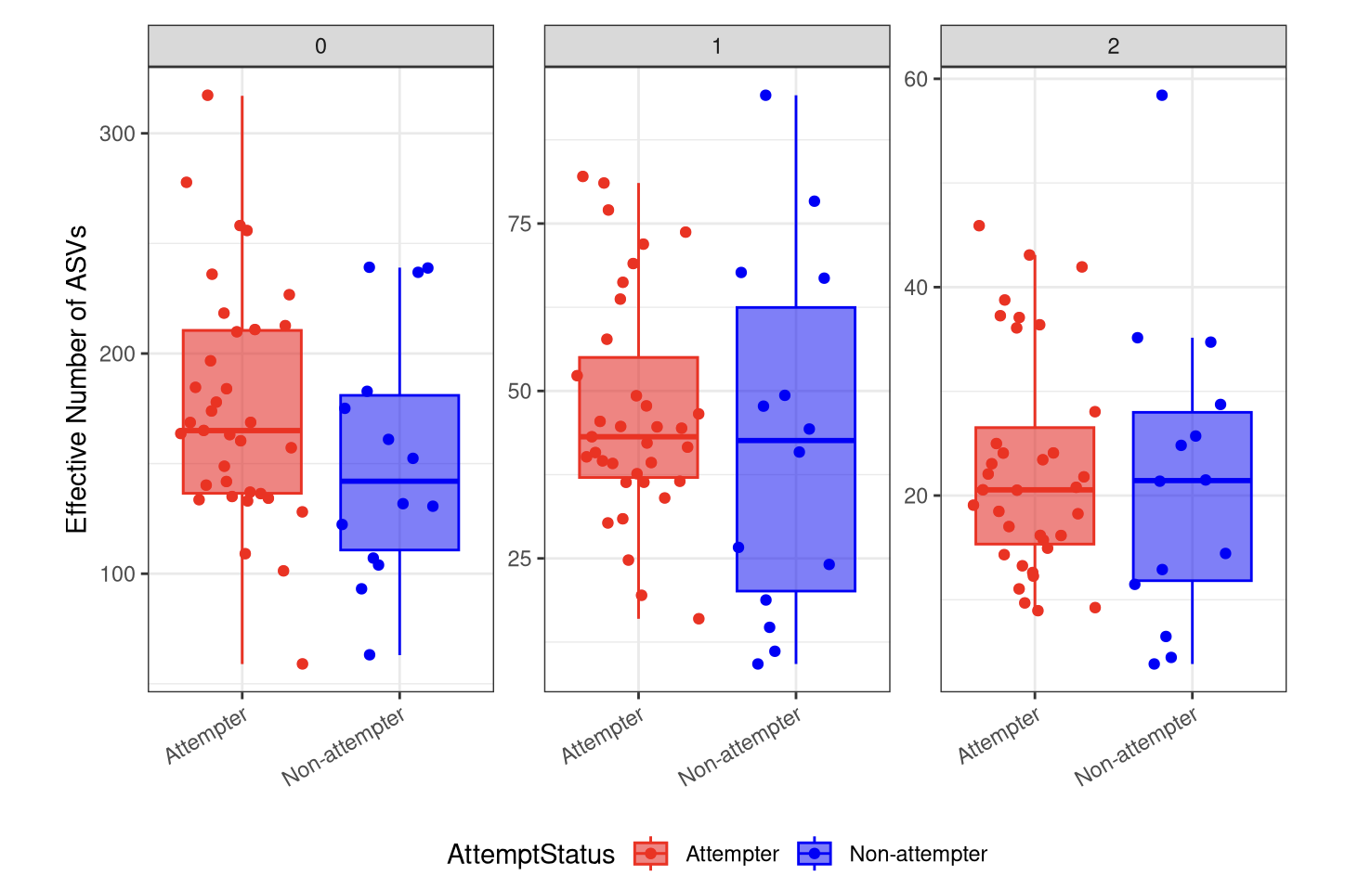
Alpha diversity does not differ between hospitalized MDD suicide attempters and non-attempters
Wilcoxon rank-sum tests showed no statistically significant differences in alpha diversity between suicide attempters and non-attempters
Diversity Metric | P-value
Richness q=0 | 0.0799
Shannon q=1 | 0.245
Simpson q=2 | 0.319

Slide 9
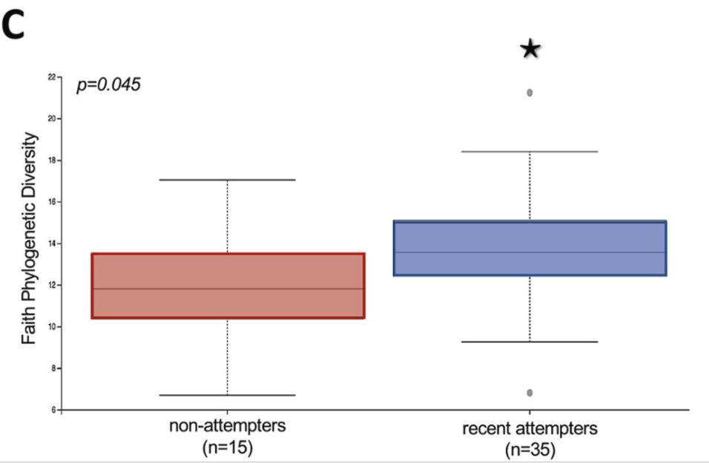
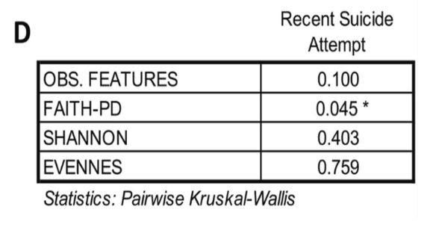
Original study shows significant differences only in Faith’s Phylogenetic Diversity
Original Study: Exhibit significantly richer microflora as measured by the Faith’s phylogenetic diversity index (p = 0.045). No significant differences were found in the other three alpha diversity measures.

Slide 10
Hospitalized MDD Attempters Are Hypothesized to Exhibit Distinct Beta Diversity
Null hypothesis: Gut microbial community composition does not differ between hospitalized MDD patients with a recent suicide attempt and those without a history of suicide attempts.
Alternative hypothesis: Hospitalized MDD patients with a recent suicide attempt exhibit distinct microbial species and community composition compared to MDD patients without a history of suicide attempt.

Slide 11
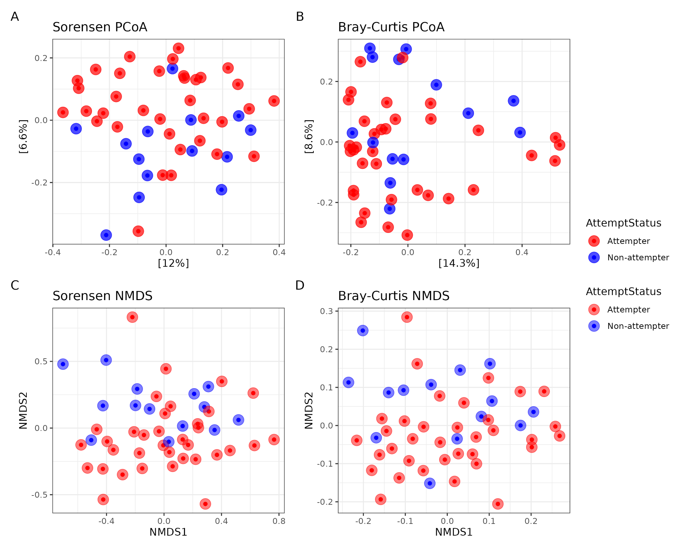
Beta Diversity Analyses Reveal Substantial Overlap Between Attempters and Non-Attempters
Both PCoA and NMDS plots show substantial overlap between attempters and non-attempters, indicating that microbial communities are not strongly differentiated by AttemptStatus

Slide 12
Attempt Status Explains Minimal Variation in Beta Diversity and Is Not Statistically Significant
PERMANOVA analysis using Sorensen and Bray-Curtis distances revealed that AttemptStatus explained only ~2 to 3 % of variation in microbial community composition, with no significant differences in microbial community composition between sucide attempters and non-attempters
Distance Metric | Variation Explained (R²) | PERMANOVA p-value | Dispersion p-value
Sorensen | 2.56% | 0.098 | 0.443
Bray-Curtis | 2.56% | 0.128 | 0.822

Slide 13
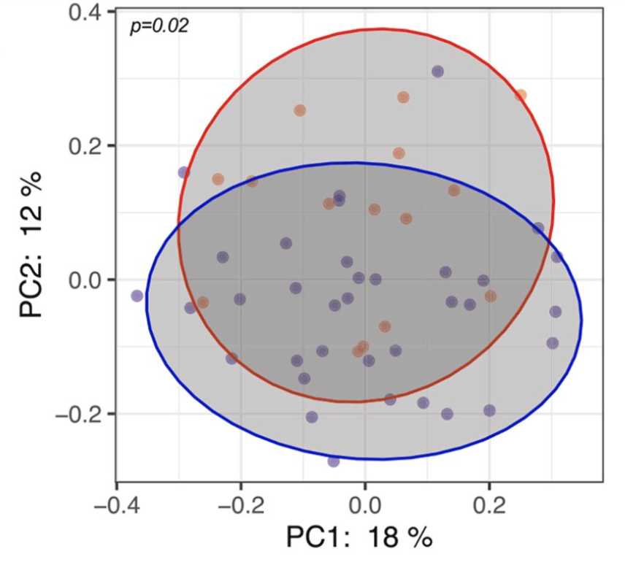
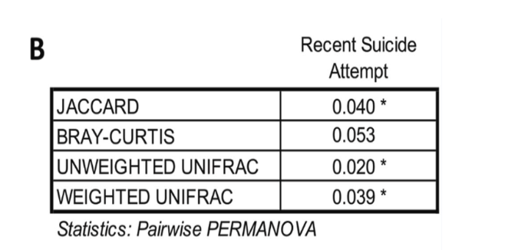
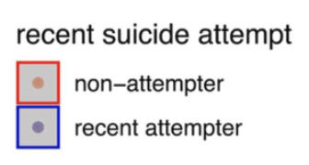
Original Study Reports Significant Beta Diversity Differences Between Attempters and Non-Attempters
Original Study: The significant differences between the two clinical were more pronounced in beta diversity measures

Slide 14
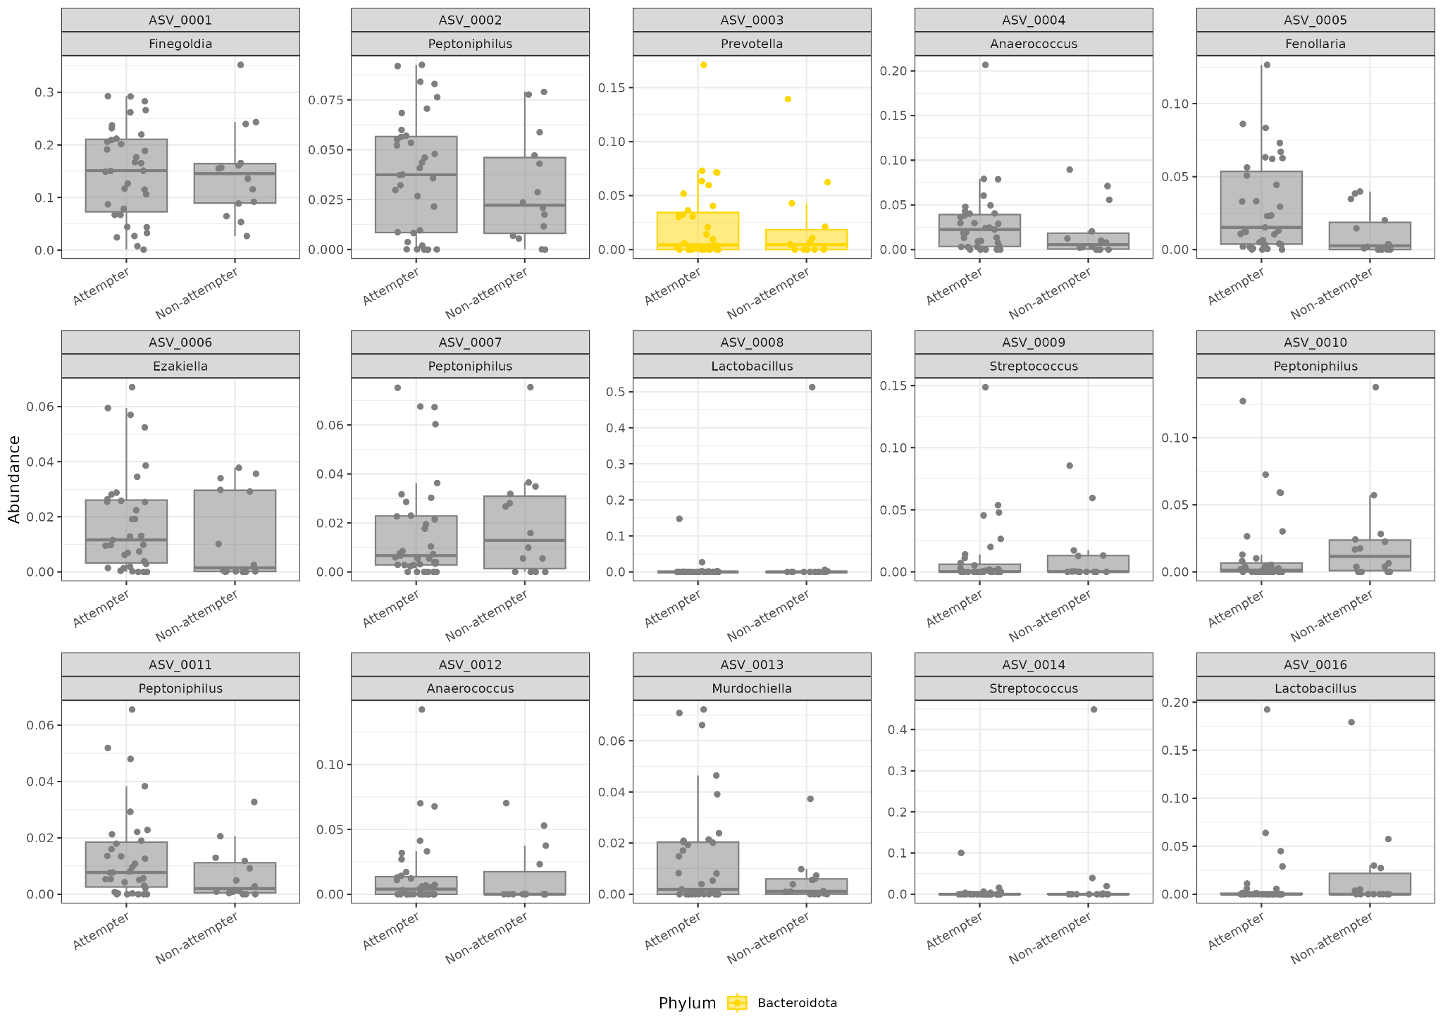
Although overall composition is similar, three specific genera show increased abundance in attempters

Slide 15



Although overall composition is similar, three specific genera show increased abundance in attempters
Fernollaria
Peptoniphilus
Murdochiella

Slide 16
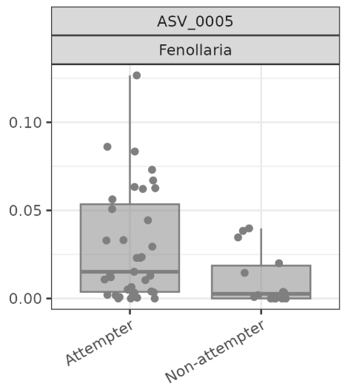
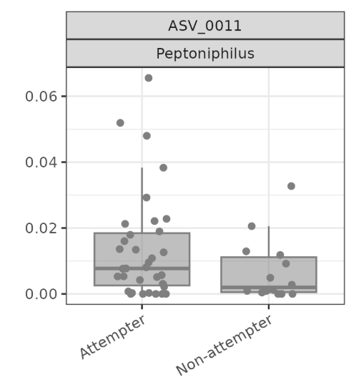
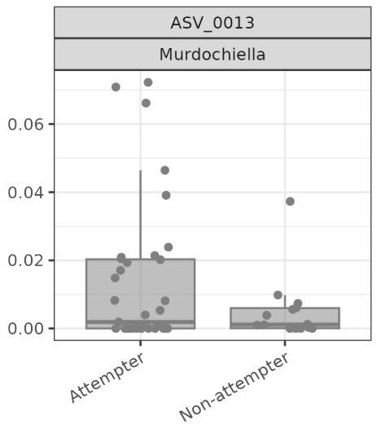
Three Key Genera Show Elevated Abundance in MDD Patients and Risk-Associated Populations
Fenoilaria: the genus Fenoilaria was exclusively present in MDD patients compared to healthy controls (Fontana et al.).
Peptoniphilus: Peptoniphilus were increased in sever MDD patients (Zhong et al.).
Murdochiella: Murdochiella abundance was significantly increased in individuals reporting childhood physical abuse, a major environmental risk factor associated with MDD development (Rohr et al.).

Slide 17
Overall gut microbiome remains stable, but specific genera show increased abundance in attempters
Microbial diversity remains stable between groups
Alpha diversity does not differ between hospitalized MDD attempters and non-attempters
Beta diversity shows no significant community separation between groups
Dominant taxa remain consistent across hospitalized MDD groups
Bacillota and Bacteroidota dominate gut microbial composition
Other phyla remain low abundance with minimal phylum-level differences
Suicide attempt status is not associated with large-scale microbiome restructuring
No significant diversity or compositional shifts were detected
However, several individual ASVs and genera show increased abundance in suicide attempters

Slide 18
Large-Scale Gut Microbiome Restructuring Does Not Characterize Suicidal Behavior in Hospitalized MDD
Suicide attempt status did not produce major shifts in gut microbial diversity or overall community composition
Large-scale microbiome restructuring may not characterize suicidal behavior in hospitalized MDD patients
Finer-scale microbial or functional mechanisms along the gut–brain axis should be investigated in future studies

Slide 19
Bibliography
Prandovszky, Emese, et al. “Altered Gut Microbial Diversity, Composition, and Metabolomic Potential in Patients with Major Depressive Disorder and Recent Suicide Attempt.” Brain, Behavior, & Immunity - Health, vol. 48, 5 Aug. 2025, p. 101081, www.sciencedirect.com/science/article/pii/S2666354625001395?via%3Dihub, https://doi.org/10.1016/j.bbih.2025.101081.
Fontana, Andrea, et al. “Exploring the Role of Gut Microbiota in Major Depressive Disorder and in Treatment Resistance to Antidepressants.” Biomedicines, vol. 8, no. 9, 27 Aug. 2020, p. 311, https://doi.org/10.3390/biomedicines8090311.
Zhong, Qi, et al. “Differential Gut Microbiota Compositions Related with the Severity of Major Depressive Disorder.” Frontiers in Cellular and Infection Microbiology, vol. 12, 11 July 2022, https://doi.org/10.3389/fcimb.2022.907239.
Rohr, Jessica C, et al. “History of Childhood Physical Abuse Is Associated with Gut Microbiota Diversity among Adult Psychiatric Inpatients.” Journal of Affective Disorders, vol. 331, 1 June 2023, pp. 50–56, https://doi.org/10.1016/j.jad.2023.03.023.
Borkent, Jenny, et al. “Role of the Gut Microbiome in Three Major Psychiatric Disorders.” Psychological Medicine, 4 May 2022, pp. 1–21, www.cambridge.org/core/journals/psychological-medicine/article/role-of-the-gut-microbiome-in-three-major-psychiatric-disorders/D1B42C227DBAD58750E4A44DEA041BC5, https://doi.org/10.1017/S0033291722000897.

Slide 20
Thank You, and Questions?

